Slide 1
Parallel Computer Architecture/Programming Models
Introduction to Parallel and Distributed Computing

Slide 2
Learning Outcomes
Define parallelism in hardware and software.
List parallel computer architectures types
Explain different parallel computer architectures.

Slide 3
Outline
Parallel architecture types
Instruction-level parallelism
Vector processing
Flynn’s Taxonomy
Shared memory
Memory organization: UMA, NUMA
Coherency: CC-UMA, CC-NUMA
Interconnection networks
Distributed memory
Clusters
Clusters of SMPs
Heterogeneous clusters of SMPs

Slide 4
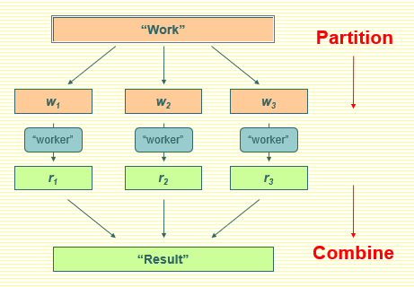
Parallelism and Parallel vs. Distributed
Parallel computing generally means:
Vector processing of data
Multiple CPUs in a single computer
Distributed computing generally means:
Multiple CPUs across many computers

Slide 5
Different Workers
Different threads in the same core
Different cores in the same CPU
Different CPUs in a multi-processor system
Different machines in a distributed system

Slide 6



How do you get parallelism in the hardware?
Task Parallelism
Distribute Instructions across processors
Data parallelism
Distribute Instructions across processors
Instruction-Level Parallelism (ILP)
Bit-level parallelism
Processor parallelism
Increase number of processors
Memory system parallelism
Increase number of memory units
Increase bandwidth to memory
Communication parallelism
Increase amount of interconnection between elements
Increase communication bandwidth

Slide 7
Parallel Architecture Types
Uniprocessor
Scalar processor
Vector processor
Data Parallel - Flynn’s Taxonomy (SISD, SIMD, MIMD)
processor
memory
processor
vector
memory
processor
…
memory

Slide 8
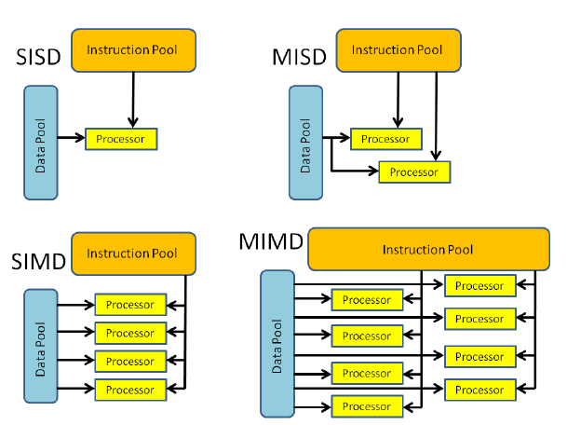
Flynn’s Taxonomy
…

Slide 9
Parallel Architecture Types
SPMD
Shared Memory Multiprocessor (SMP)
Shared memory address space
Bus-based memory system
Interconnection network
…
processor
processor
bus
memory
processor
…
processor
network
…
memory

Slide 10
Parallel Architecture Types
SPMD
In computing, single program, multiple data is a technique employed to achieve parallelism; it is a subcategory of MIMD
Shared Memory Multiprocessor (SMP)
Shared memory address space
Bus-based memory system
Interconnection network
…
processor
processor
bus
memory
processor
processor
…
network
…
memory

Slide 11
Parallel Architecture Types (2)
Distributed Memory Multiprocessor
Message passing between nodes
Massively Parallel Processor (MPP)
Many, many processors
memory
memory
…
processor
processor
interconnection network
processor
processor
…
memory
memory

Slide 12
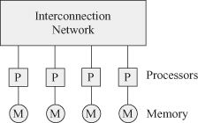
Distributed-memory multiprocessor architecture.
In a distributed-memory multiprocessor, each memory module is associated with a processor as shown in below Fig. Any processor can directly access its own memory. A message passing (MP) mechanism is used in order to allow a processor to access other memory modules associated with other processors. Message passing interface (MPI) is a language-independent communication protocol.

Slide 13
Parallel Architecture Types (2)
Cluster of SMPs
Shared memory addressing within SMP node
Message passing between SMP nodes
Can also be regarded as MPP if processor number is large
M
M
…
…
P
…
P
P
P
network
interface
interconnection network
P
…
P
P
…
P
…
M
M

Slide 14
Parallel Architecture Types (3)
Multicore
Multicore processor
GPU accelerator
“Fused” processor accelerator
C
C
C
C
cores can be hardware multithreaded (hyperthread)
m
m
m
m
memory
processor
PCI
memory
processor
memory

Slide 15
Parallel Architecture Types (3)
Multicore SMP+GPU Cluster
Shared memory addressing within SMP node
Message passing between SMP nodes
GPU accelerators attached
M
…
M
…
P
…
P
P
P
interconnection network
P
…
P
P
…
P
M
…
M

Slide 16

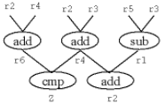
Instruction-Level Parallelism
Simultaneous execution of multiple instructions of a Program.
Opportunities for splitting up instruction processing
Pipelining within instruction
Pipelining between instructions
Overlapped execution
Multiple functional units
Out of order execution
Multi-issue execution
Superscalar processing
Hardware multithreading (hyperthreading)
Notes:
Instruction Pipelining studied in OS - Oral Quiz.

Slide 17
Parallelism in Single Processor Computers
History of processor architecture innovation
ILP
Unpipelined
Pipelined
Vector
multiple
E unit
only scalar
instructions
vector
instructions
horizontal
control
issue-when-
ready
register to register
memory to memory
CDC
6600
FPS
AP-120B
CDC
7600
CRAY-1
CDC
Cyber-205
scoreboarding
VLIW
IBM
360/91
reservation stations

Slide 18
Home Task
Read about
Bit-Level Parallelism

Slide 19
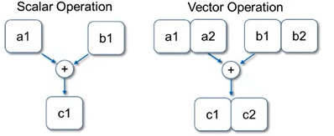
Vector Processing
Scalar processing
Processor instructions operate on scalar values
integer registers and floating-point registers
Vectors
Set of scalar data
Vector registers
integer, floating point (typically)
Vector instructions operate on vector registers (SIMD)
Issues
Vector unit pipelining
Multiple vector units
Vector chaining

Slide 20
Next Class
Parallel Computer Architecture/Programming Models (Continued..)
Architecture’s Classification according to Memory

